Slide 1

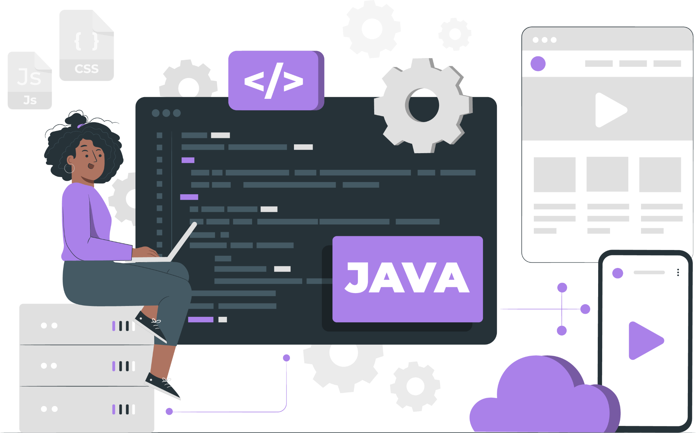
Lecture
Collection and
Map API in Java

Slide 2
List of Concepts Involved:
Why Collection?
Collection Hierarchy
ArrayList
LinkedList
ArrayDeque
PriorityQueue
TreeSet
HashSet
LinkedHashSet
Iterator , List Iterator
Introduction to Map in Java
Map Hierarchy
HashMap
Other Inbuilt classes and Inbuilt methods under Map Hierarchy

Slide 3
Why Collection?
The Collection Framework(1.2V) is a set of interfaces, implementations, and algorithms that provide a standardized way to work with groups of objects. It was introduced to simplify the process of storing, manipulating, and processing collections of data in Java applications.

Slide 4
Collection Hierarchy
Iterable
Class
Collection
Interface
Implements
List
Queue
Set
Extends
Priority Queue
HashSet
ArrayList
Deque
LinkedHashSet
LinkedList
Vector
ArrayDeque
SortedSet
Stack
TreeSet

Slide 5
List Interface
List interface is the child interface of Collection interface. It inhibits a list type data structure in which we can store the ordered collection of objects. It can have duplicate values.
List interface is implemented by the classes ArrayList, LinkedList, Vector, and Stack.

Slide 6
ArrayList
The ArrayList class implements the List interface.
It uses a dynamic array to store the duplicate element of different data types.
The ArrayList class maintains the insertion order and is non-synchronized.
The elements stored in the ArrayList class can be randomly accessed.

Slide 7
LinkedList
LinkedList implements the List and Deque interface.
It uses a doubly linked list internally to store the elements.
It can store the duplicate elements.
It maintains the insertion order and is not synchronized.
In LinkedList, the manipulation is fast because no shifting is required.

Slide 8
ArrayDeque
ArrayDeque class implements the Deque interface.
It facilitates us to use the Deque. Unlike queue, we can add or delete the elements from both the ends.
ArrayDeque is faster than ArrayList and Stack and has no capacity restrictions.

Slide 9
PriorityQueue
The PriorityQueue class implements the Queue interface.
It holds the elements or objects which are to be processed by their priorities. PriorityQueue doesn't allow null values to be stored in the queue.

Slide 10
TreeSet
TreeSet class implements the Set interface that uses a tree for storage.
TreeSet also contains unique elements.
However, the access and retrieval time of TreeSet is quite fast.
The elements in TreeSet stored in ascending order.

Slide 11
HashSet
HashSet class is used to create a collection that uses a hash table for storage. It inherits the AbstractSet class and implements Set interface.
The important points about HashSet class are:
HashSet stores the elements by using a mechanism called hashing.
HashSet contains unique elements only.
HashSet allows null value.
HashSet class is non synchronized.
The initial default capacity of HashSet is 16, and the load factor is 0.75.

Slide 12
LinkedHashSet
LinkedHashSet class is a Hashtable and Linked list implementation of the Set interface. It inherits the HashSet class and implements the Set interface.
The important points about the LinkedHashSet class are:
LinkedHashSet class contains unique elements only like HashSet.
provides all optional set operations and permits null elements.
is non-synchronized.
maintains insertion order.

Slide 13
Iterator , List Iterator
An Iterator is an interface and we can traverse the elements of a list in a forward direction whereas a ListIterator is an interface that extends the Iterator interface and we can traverse the elements in both forward and backward directions.
An Iterator can be used in these collection types like List, Set, and Queue whereas ListIterator can be used in List collection only.
The important methods of Iterator interface are hasNext(), next() and remove() whereas important methods of ListIterator interface are add(), hasNext(), hasPrevious() and remove().

Slide 14
Legacy classes and Enumeration
Legacy classes
Legacy classes refers to the older classes that were included in the early versions of Java and have since been replaced by newer, more efficient classes. One such class is Enumeration, which is a legacy interface that was used to traverse collections before the introduction of the Iterator interface.
The Legacy classes are Dictionary, Hashtable, Properties, Stack, and Vector. The Legacy interface is the Enumeration interface.

Slide 15
Enumeration Interface
The Enumeration interface is the only legacy interface. It defines methods, which help us to enumerate the elements in a collection of objects. This interface has been suspended by Iterator. It contains only 2 methods as shown here:
boolean hasMoreElements(): Checks if the enumeration contains more elements. If it contains more elements, then it returns true, else it returns false.
Object nextElement(): Returns the next element of the enumeration. If there are no more elements to retrieve then it throws NoSuchElementException.

Slide 16
Introduction to Map in Java
A Map is an interface that represents a collection of key-value pairs, where each key and value pair is known as an entry. A Map contains unique keys.
A Map is useful if you have to search, update or delete elements on the basis of a key.

Slide 17
Map Hierarchy
Map Interface
<<Interface>> Map
<<Interface>> SortedMap
Hashtable
HashMap
<<Interface>> NavigableMap
LinkedHashMap
TreeMap
implements
extends

Slide 18
HashMap
Java HashMap allows null key and null values.
HashMap is not an ordered collection. You can iterate over HashMap entries through keys set but they are not guaranteed to be in the order of their addition to the HashMap.
HashMap is almost similar to Hashtable except that it’s non-synchronized and allows null key and values.

Slide 19
In-built classes in Map Hierarchy
The three primary classes that implement map in Java are:
HashMap
LinkedHashMap
TreeMap

Slide 20
Inbuilt methods under Map Hierarchy
Some of the Inbuilt Methods are:
clear()
containsKey(Object)
containsValue(Object)
entrySet()
equals(Object)
get(Object)
hashCode()
isEmpty()
keySet()
put(Object, Object)

Slide 21
THANK YOU

